Slide 1



F
I
R
S
T
C
O
R
N
A
N
I
T
H
I
S
15.20-38
A free CD of this message will be available following the service
It will also be available for podcast later this week at calvaryokc.com

Slide 2
Federal headship refers to the representation of a group united under a federation or covenant. For example, a country's president may be seen as the federal head of his nation, representing and speaking on its behalf before the rest of the world.
O
A
N
S
15.20-38
I
I
F
I
R
S
T
C
R
N
T
H

Slide 3
F. F. Bruce – “To Paul, Adam was more than a historical individual, the first man; he was also what his name means in Hebrew - ‘humanity.’ The whole of humanity is viewed as having existed at first in Adam.”
O
A
N
S
15.20-38
I
I
F
I
R
S
T
C
R
N
T
H

Slide 4
A. W. Pink – “God has been infinitely more honoured by the obedience of the last Adam than He was dishonored by the disobedience of the first Adam.”
O
A
N
S
15.20-38
I
I
F
I
R
S
T
C
R
N
T
H

Slide 5
The two resurrections
1st Easter morning
2nd Resurrection
1st Resurrection (approx. 3000 years)
500
1000
1500
2000
2500
Church Age
Millennium
O
A
N
S
15.20-38
I
I
F
I
R
S
T
C
R
N
T
H

Slide 6
John 12:23-24 - ²³ But Jesus answered them, saying, “The hour has come that the Son of Man should be glorified. ²⁴ Most assuredly, I say to you, unless a grain of wheat falls into the ground and dies, it remains alone; but if it dies, it produces much grain.”
O
A
N
S
15.20-38
I
I
F
I
R
S
T
C
R
N
T
H

Slide 7
2 Cor. 5:1–4 - ¹ For we know that if our earthly house, this tent, is destroyed, we have a building from God, a house not made with hands, eternal in the heavens. ² For in this we groan, earnestly desiring to be clothed with our habitation which is from
O
A
N
S
15.20-38
I
I
F
I
R
S
T
C
R
N
T
H

Slide 8
heaven, ³ if indeed, having been clothed, we shall not be found naked. ⁴ For we who are in this tent groan, being burdened, not because we want to be unclothed, but further clothed, that mortality may be swallowed up by life.
O
A
N
S
15.20-38
I
I
F
I
R
S
T
C
R
N
T
H

Slide 9
Foolish one – aphrōn – without a mind
O
A
N
S
15.20-38
I
I
F
I
R
S
T
C
R
N
T
H

Slide 10
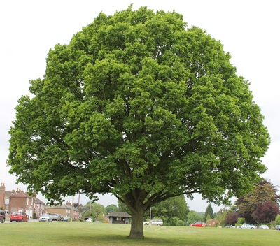
O
A
N
S
15.20-38
I
I
F
I
R
S
T
C
R
N
T
H

Slide 11
2 Cor. 12:2-4 - ² I know a man in Christ who fourteen years ago — whether in the body I do not know, or whether out of the body I do not know, God knows —such a one was caught up to the third heaven. ³ And I
O
A
N
S
15.20-38
I
I
F
I
R
S
T
C
R
N
T
H

Slide 12
know such a man — whether in the body or out of the body I do not know, God knows — ⁴ how he was caught up into Paradise and heard inexpressible words, which it is not lawful for a man to utter
O
A
N
S
15.20-38
I
I
F
I
R
S
T
C
R
N
T
H

Slide 13
1st Heaven
(Atmosphere)
2nd Heaven
(Outer space)
3rd Heaven
(Throne of God)
O
A
N
S
15.20-38
I
I
F
I
R
S
T
C
R
N
T
H

Slide 14



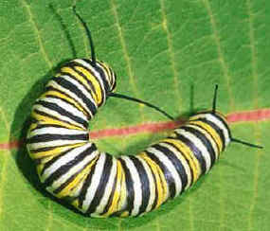
O
A
N
S
15.20-38
I
I
F
I
R
S
T
C
R
N
T
H

Slide 15
David peaked
God Made
Adam Bit
Saul Freaked
The Bible in 50 Words
Jesus born
Noah Arked
Abraham split
Prophets warned
Love walked
Joseph ruled
Jacob fooled
God Talked
Hope Died
Bush talked
Moses balked
Anger crucified
Pharaoh Plagued
People walked
Love rose
Spirit flamed
Sea divided
Tablets guided
Word spread
God remains
Promise
landed
O
A
N
S
15.20-38
I
I
F
I
R
S
T
C
R
N
T
H

